Slide 1
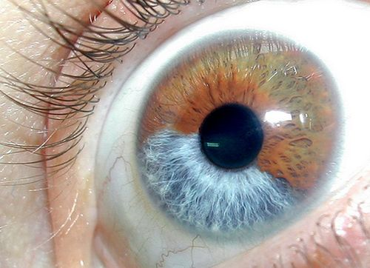
MUTATIONS
Single-Gene Disorders – just one gene is changed or is not there. ColourBlindness and Haemophilia (P. 41-42). Albinism (P. 45).
2. Chromosome Abnormality – Entire (full) chromosomes are added (Down’s Syndrome, Page 17), or are not there, or are back-to-front.
3. MultiFactorial DisOrders – Very many genes are changed, often helped by the environment. Alzheimer's Disease. Ovarian and Breast Cancer.

Slide 2
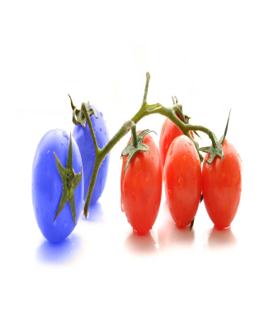
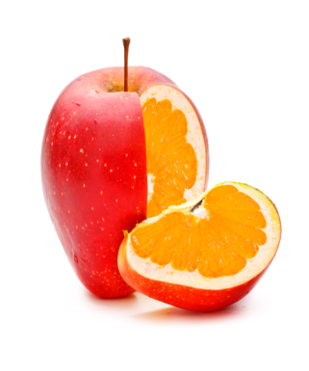
GENETIC ENGINEERING a.k.a. GENETIC MODIFICATION
Originally, selective breeding improved the quality of farm animals and crops.
Now, the plan of the DNA in an organism is slightly changed by scientists in a laboratory.
These changed plans can now be used in BioTechnology – the plans in living things are being manipulated into helping us in medicines (like in making insulin for Diabetics) and to clean up the environment (like in use for oil-spills).

Slide 3
CLONING
This is where there is only one parent, and the child has exactly the same plan as that parent.
Nature does this Vegetatively – Asexual reproduction.
Scientists now do it with female animals (Dolly & Futhi):
Take a diploid stem-cell from SuperMom/Dad. Take out only its nucleus, & throw away the rest of the cell.
Take an egg cell (ovum) from any other female. Throw away only its nucleus.
Put SuperMom/Dad’s nucleus in this empty egg cell.
Give it a controlled electrical shock – it starts dividing.
Put it in the womb of any (third) Mommy.
The exact copy of SuperMom/Dad is the result.

